Slide 1
Image Segmentation with CNN
Zhihao Zhao

Slide 2
Papers
Fully Convolutional Networks for Semantic Segmentation
DeepLab: Semantic Image Segmentation with Deep Convolutional Nets, Atrous Convolution, and Fully Connected CRFs(ing…)
Instance-sensitive Fully Convolutional Networks
Fully Convolutional Instance-aware Semantic Segmentation

Slide 3
FCN
Fully Convolutional Networks for Semantic Segmentation
Jonathan Long, et.al.

Slide 4
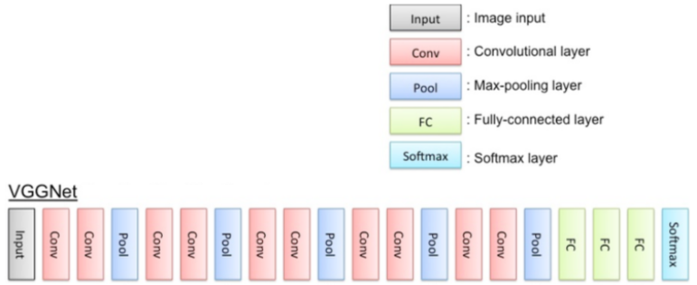
1. From classification network to segmentation network
c-last: last layer before first fully connected layer.
fc1: first fully connected layer.
“c-last -> fc1” simply rearrange all feature
maps in c-last to a vector. And fc1->fc2->fc3
produces non-spatial outputs.
So to remove these fully connected layers
and exploit existing classification network(VGG, Googlenet, …), convert these fc layers to convolutional layers. That’s why it’s called “Fully Convolutional Networks”
I think at least theoretically, we can simply remove these fc layers. It still can give segmentation result. But I don’t know if the result is good as converting fc to conv.
classification network VGG.

Slide 5
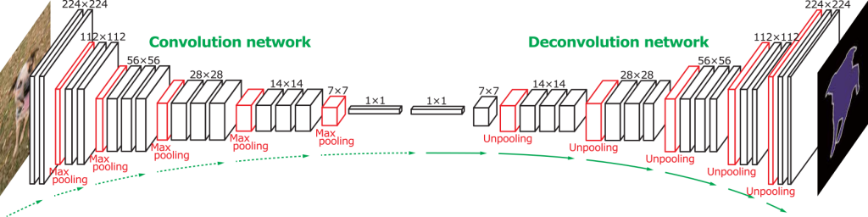
From classification network to segmentation network
After convert fc layers to convolutional layers, if we upsample the output to input image’s size, and add a 1*1 convolution layer to convert these feature maps to only one feature map, we can predict label of every pixel of the only one feature map(converts segmentation problem to classification on pixels). There exists such a operation for upsampling(you may also simply use bilinear interpolation), called transposed convolution or deconvolution(bad name). So now the whole network would like as below.

Slide 6
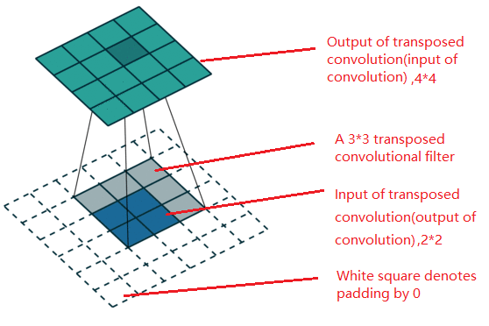
Transposed convolution(deconvolution)
From the figure, transposed convolution has the same operation with convolution.
*Transposed convolution only guarantees that the output will be a 4x4 image as well. It will not reverse the corresponding convolution perfectly. At least not concerning the numeric values.

Slide 7
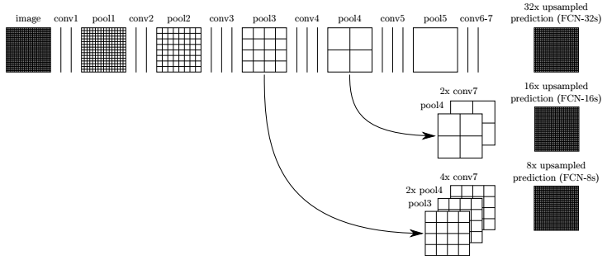
2. Combine features in different layers
If we interpret feature maps from low layers to high layers in CNN as low, middle, high semantic information on input image, we may think that combining these feature maps would gain better performance.

Slide 8
DeepLab: Semantic Image Segmentation with Deep Convolutional Nets, Atrous Convolution, and Fully Connected CRFs Liang-Chieh Chen et.al

Slide 9
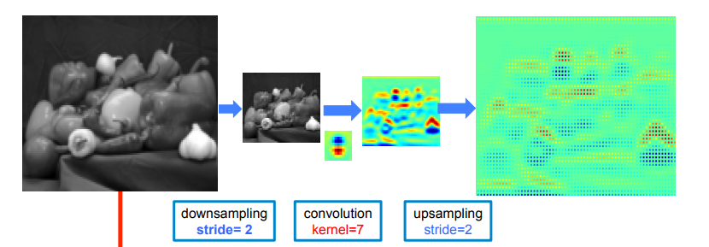
1. Shortcoming of FCN
1. Repeated combination of max-pooling and striding at consecutive layers reduces significantly the spatial resolution of the resulting feature maps, typically by a factor of 32 across each direction.
Process of pooling and unpooling in FCN
2. To avoid that happen, the author use dilated convolution[1], also called convolution with holes, atrous convolution(used in this paper).
My understanding:
1. During max-pooling and striding at consecutive layers, more and more values in feature maps are discarded.
2. The classification on every pixel partly rely on its receptive field on input image. It can be understand if we remember values in high layers stands for high level semantic feature.
[1] Multi-Scale Context Aggregation by Dilated Convolutions

Slide 10
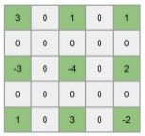

Dilated convolution
With dilated convolution, the same resolution output compared to “pooling and unpooling” in FCN, can be gained with the same receptive field of every pixel in output feature map. But avoid discarding values in “pooling and unpooling”.
-> Enlarge kernel with inserting 0 ->
3*3 filter
3*3 filter with hole =2

Slide 11
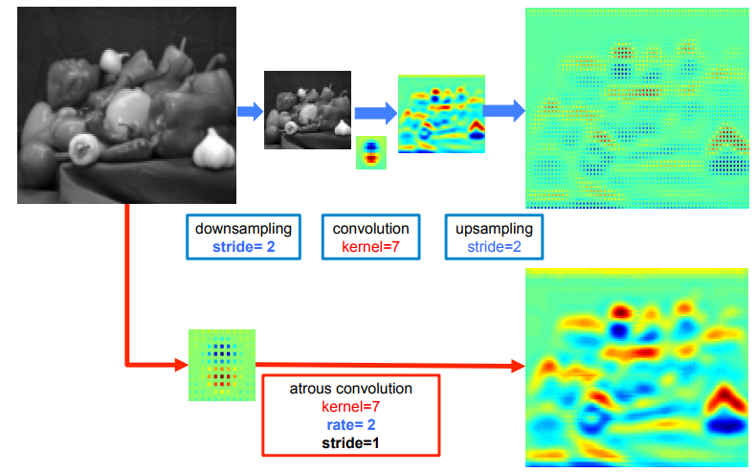
Dilated convolution
With dilated convolution, the same resolution output compared to “pooling and unpooling” in FCN, can be gained with the same receptive field of every pixel in output feature map. But avoid discarding values in “pooling and unpooling”.

Slide 12
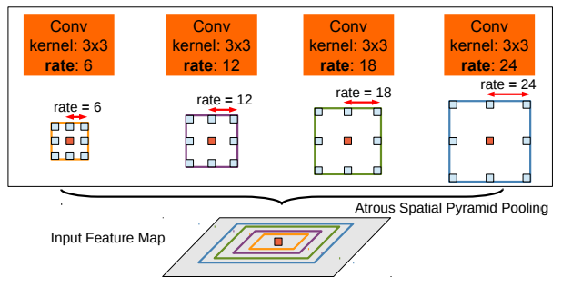
2. Multiscale image representation
Obviously, same object in different images could be different scale. 1. Atrous Spatial Pyramid Pooling as called is to solve this problem. 2. These conv filters can be parallel then the outputs are fused.
My understanding: 1. Imagining the process of dilated convolution, different rates at dilated convolution can be seen as normal convolution with resizing input feature maps/image. I don’t know why there is a word “pooling” in its name, maybe because it comes from “Spatial Pyramid Pooling”. 2. The fusion process can be simple concatenation.

Slide 13
3. Accurate boundary
To be continue…
CRF is used. More information is needed.

Slide 14
Instance-sensitive Fully Convolutional Networks
Jifeng Dai, et.al.

Slide 15
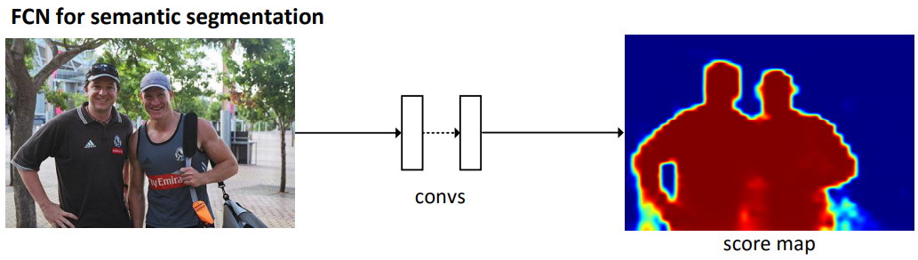
Shortcoming of FCN
Despite good accuracy and ease of usage, FCNs are not directly applicable for producing instance segments. For example, FCN cannot separate the two persons.

Slide 16
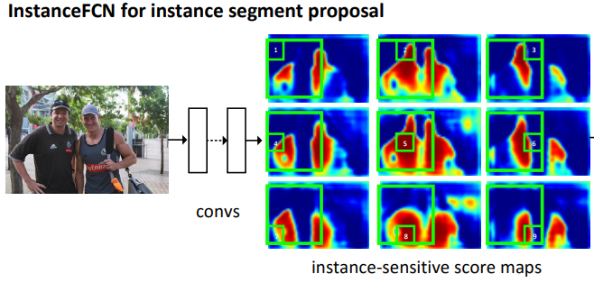
Shortcoming of FCN
In this paper, with a k*k(3×3) regular grid depicting relative positions, the author produces a set of 9 score maps. In every map, every pixel is a classifier of relative positions to an object instance. For example, every pixel in the left-top score map stands for its confidence to being left-top part of an instance.

Slide 17
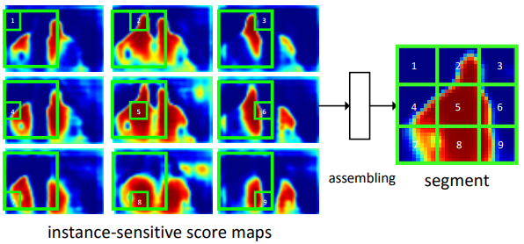
Assemble score maps
With the k*k(3*3) output score maps, it’s easy to assemble a score map for a whole instance. For a proposal(extracted by RPN, Region Proposal Network), we can get its left-top part from the left-top score map, and middle part from the middle score map … So the final score map stands for whether every pixel being inside of instance in the window. Note that we can get a whole score map at arbitrary size.

Slide 18
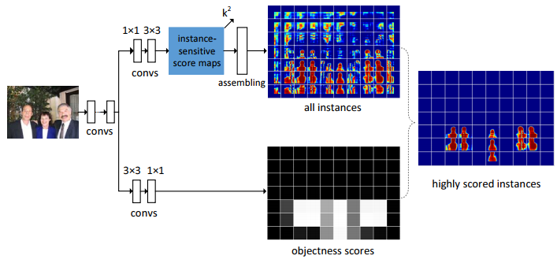
Objectness score and the network
Because some proposals do not contains an instance, extra operation is needed to classify whether a proposal contains an instance. Below is the network. Small grids in the picture are proposals. This algorithm is not end-to-end. We get masked proposal with this network. Extra network to classify category is needed.

Slide 19
Fully Convolutional Instance-aware Semantic Segmentation
Yi Li, et.al.
Top 1 on coco 2016 segmentation task.

Slide 20
Shortcoming of Instance-sensitive-FCN
Remember that in instance-sensitive-FCN:
Region proposals are extracted by RPN which is not(I think so) integrated in the network.
The final output is instance segmentation without category information.
Solution:
Integrate RPN and segmentation network simply by sharing weights in lower conv layers.
Predict category in segmentation network(integration again).

Slide 21
Predict and segment(figure on the next page)
i) Get 2 * #categories * k * k score maps.
k * k comes from “Instance-sensitive-FCN”, remember there are k*k relative regions in that network.
#categories comes from that we need score map on every category.
2 comes from that a pixel being foreground or background on an object since the same pixel can be foreground on one object but background on another (adjacent) object.
ii) Assemble 2 * #categories * k * k score maps to 2 * #categories.
This process is the same as “Instance-sensitive-FCN”.
iii) a. [Classify] Classify the instance’s category, note that background is also a category.
On every two corresponding score maps(stands for a pixel being foreground or background on a specific category , take max operation). Then we get #category score maps.
On the #category score maps, calculate average(this is exactly average-pooling), get #category scalars.
Softmax operation on the #category scalars.
b. [Segment] Get instance’s mask in the proposal.
On every pixel of every two corresponding score maps, take softmax operation, get probabilities of a pixel being foreground or background.

Slide 22
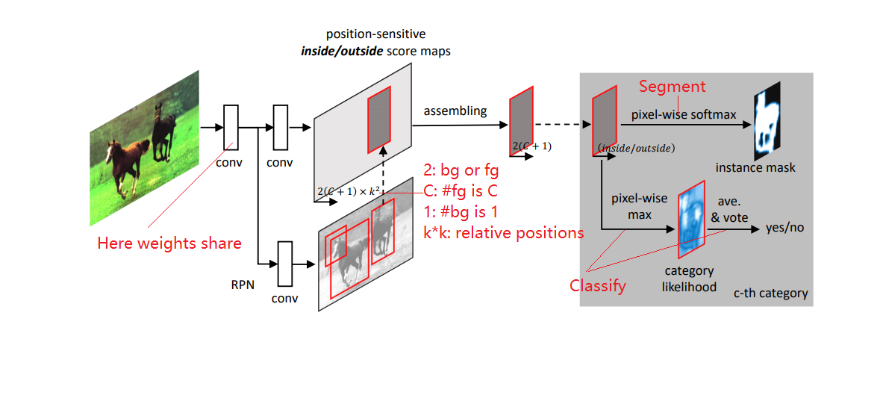
Instance-sensitive Fully Convolutional Networks

